Slide 1

AIML Part B
Randal Hong
DAAA/FT/1B/03

Slide 2
Overview Of The Workflow
1. Background Research and Importing Data
2. Preprocess Data
3. Hypertune Models
4. Select Best Model and Score
5. Conclusion
- Understand data
- Retrieve data
- Remove duplicative data (if any)
- Create dummy variables
- Impute missing data (if any)
- Scale data by Standardisation
- Selecting Important features by LassoCV
- Select hyperparameters to tune for each model
- Find the best hyperparameters for each model
- Choose best model from the scores
- Test and score with test data
- Compare final model with a dummy baseline
- Determine which features are deemed important by the model

Slide 3
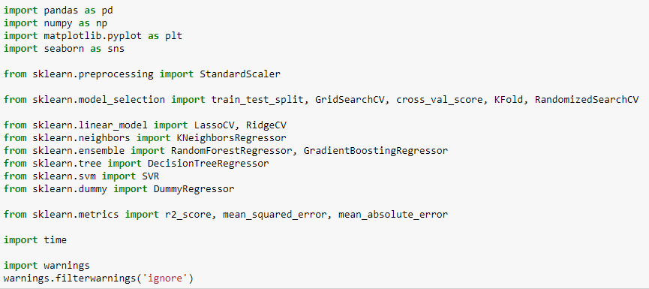
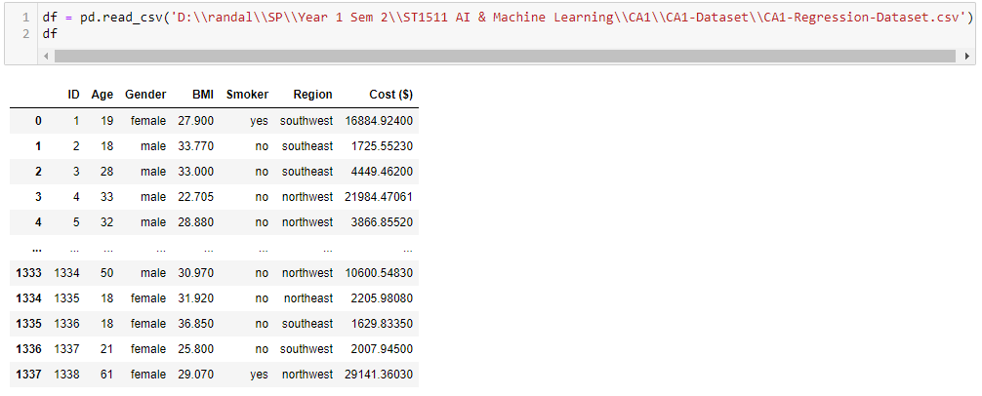
1. Importing Data
We will first import the required modules
Then we will load the data

Slide 4
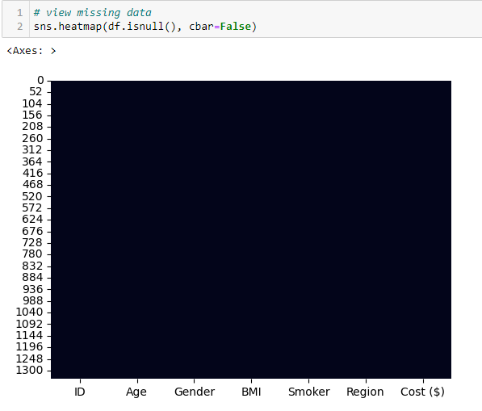
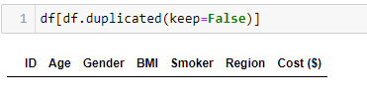
2. Preprocess Data – Check For Missing/Duplicative Data
Since there is no data in the DataFrame for duplicated data, we can say that there is no duplicative data
Since the heatmap of null values is all black, there is no missing values

Slide 5
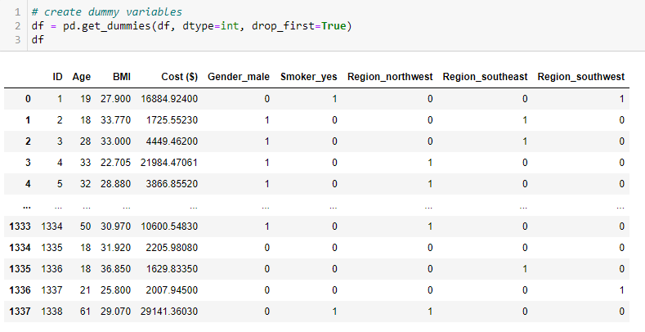
2. Preprocess Data – Create Dummy Variables For Categorical Data
As Regression models can only work with continuous data, we will create dummy variables for each categorical feature to convert them from categorical data to continuous data

Slide 6
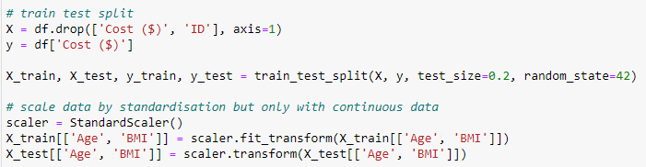
2. Preprocess Data – Scale Data Using Standardisation
As the ranges of the data vary and we do not want one feature to influence the model more than the others, we will scale our data using standardisation but only for features with continuous data
We will also remove the ID column as it probably will not influence the models' performances and the purpose of the ID column is to make sure that if there is more than one patient with the exact same features as another patient, it will not be treated as duplicative data

Slide 7
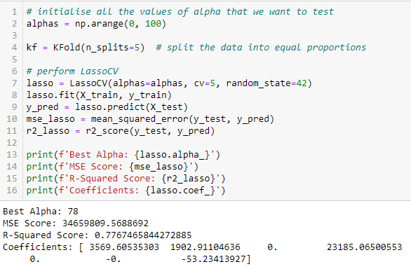
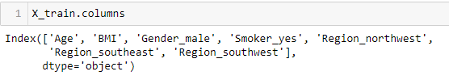
2. Preprocess Data – Selecting Important Features By LassoCV
From the output above, we can see that the LassoCV model has identified features that are deemed unnecessary to getting the predicted price
However, I do think that Region_northwest and Region_southeast will influence the cost as some regions may have lesser hospitals or some locations only provide some niche treatments which will affect the price
I also think that the gender will affect the price as different genders have different types of diseases which will affect the price
Hence, I will have one dataset with the dropped features and one without and compare them to see which one yields the best results for the model

Slide 8
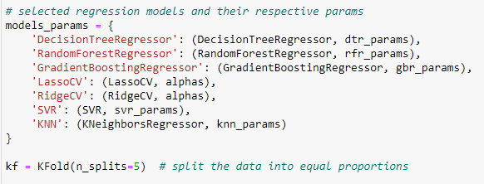
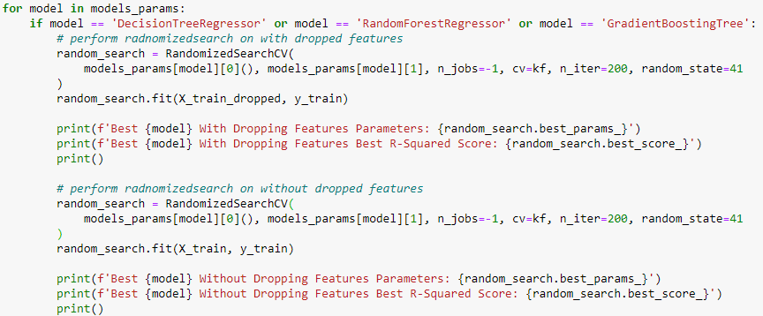
3. Hypertune Models
We used KFold instead of StratifiedKFold as StratifiedKFold is designed for categorical data and not continuous data
We will first split the for loop into 3 conditions:
1. Model is either DecisionTreeRegressor or RandomForestRegressor or GradientBoostingRegressor
This is because there is quite alot of parameters for these 3 models that we want to hypertune
Hence, using RandomizedSearchCV would be faster than doing GridSearchCV to find all the possible combinations

Slide 9
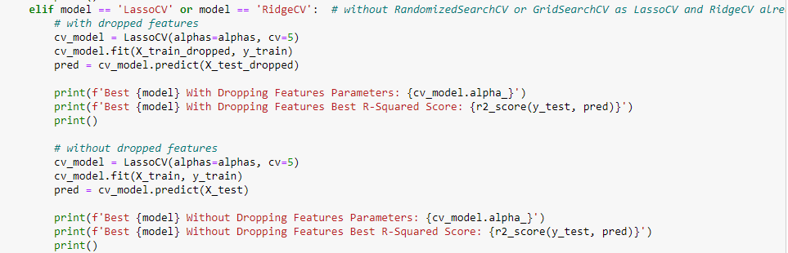
3. Hypertune Models
2. Model is either LassoCV or RidgeCV
We are separating this as the code for these two models are different as they perform their own cross-validation and hence we cannot use RandomizedSearchCV or GridSearchCV to hypertune them

Slide 10
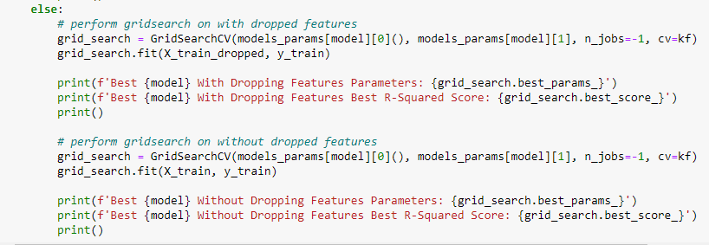
3. Hypertune Models
3. Remaining Models
We will perform GridSearchCV on these models as they do not have that many parameters to hypertune and can afford to find the best parameters out of all the possible combinations

Slide 11
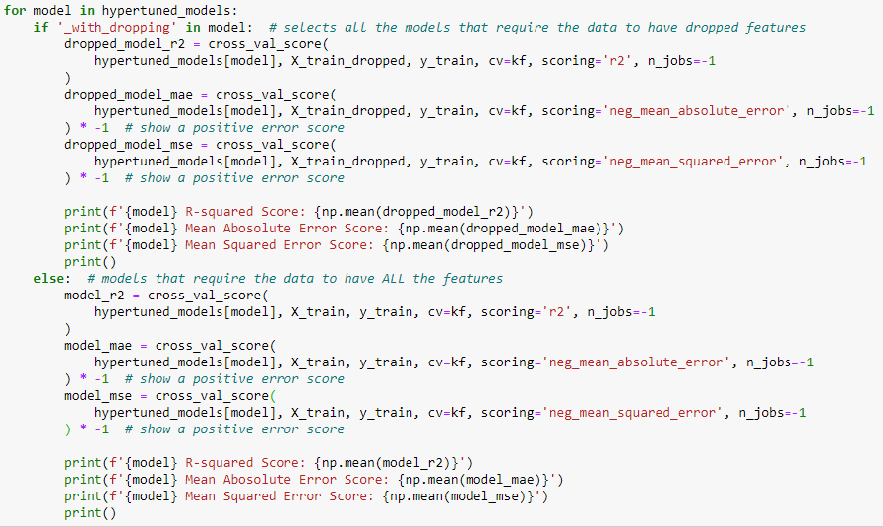
3. Hypertune Models – Adding Different Scoring Metrics
Although R-squared measures the proportion of total variance, it does not measure the errors that the model makes
Hence, we will use cross_val_score to get the Mean Absolute Error (MAE) and Mean Squared Error (MSE)
For the scoring of cross_val_score for MAE and MSE, we use neg_mean_absolute_error and neg_mean_squared_error as the lower the error score, the better the model is
However, cross_val_score will take the best score (highest), which is the opposite of what we want
Hence, we will have the MAE and MSE scores to be negative and times it by -1 afterwards to make it a positive number for easier interpretation
For simplicity, we will only be taking the hypertuned models with a R-Squared score of 0.8 and above

Slide 12
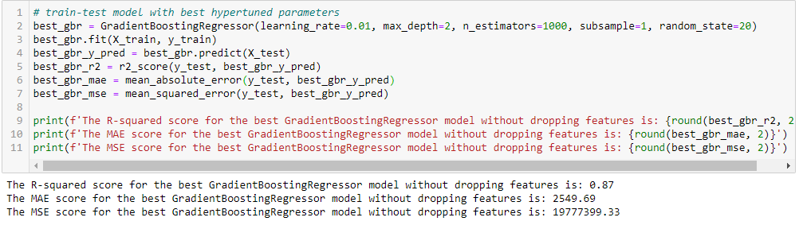
4. Selecting Best Model and Test and Score
From the hypertuning of the models, we have found that GradientBoostingRegressor without the dropped features performs the best (highest R-Squared score and lowest MAE and MSE score)
Hence, we shall use it as our final model
However, the score that we got from GridSearchCV is not accurate as it was tested against data that the model has already seen before
Thus, to truly test the model’s performance, we will need to test it against X_test, which contains data that the model has not seen yet

Slide 13
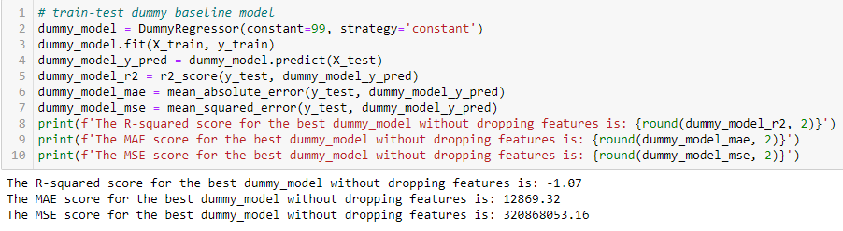
5. Conclusion – Test and Score Dummy Baseline Model
To compare our best model with a dummy baseline, we can use DummyRegressor() and test and score it
We will also fit the dummy baseline model with the same type of data (without dropping features) so that it is a fair comparison with the best GradientBoostingregerssor model

Slide 14
5. Conclusion – Compare GradientBoostingRegressor Model With Dummy Baseline Model
From the R-Squared score difference, we can tell that our GradientBoostingRegressor model outperforms the dummy baseline model by 1.94

Slide 15
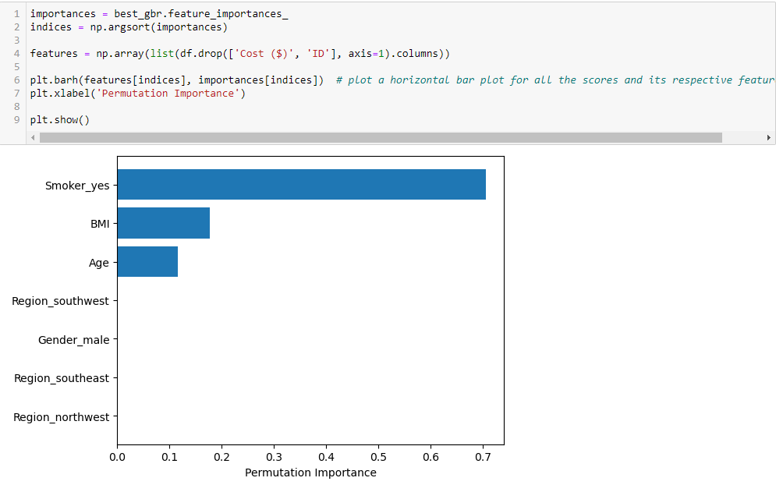
5. Conclusion – Determining Which Features The GradientBoostingRegressor Model Considers Important
The GradientBoostingRegressor model has a property called feature_importances_ which is an array of the features’ importance which we can use to determine which features the model considers important
From the horizontal bar plot shown on the right, we can tell that the top 3 features that are deemed important by the GradientBoostingRegressor model are Smoker_yes (whether the patient is a smoker), BMI and Age in determining the hospital fee for each patient

